Slide 1
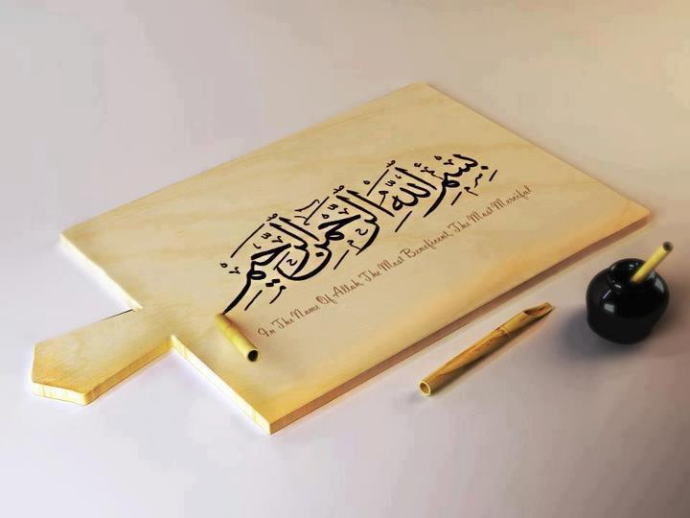

Slide 2
Final Year Project Presentation
Haroon-ur-Rashid
(2011-SE-41)
Junaid Ahmed Butt
(2011-SE-22)
Saddam Hussain
(2011-SE-29)
BS (Software Engineering)
Session: 2011-2015
Supervisor
Engr. Muhammad Zaman Fakhar
DEPARTMENT OF SOFTWARE ENGINEERING
FACULTY OF SCIENCES & ENGINEERING
UNIVERSITY OF AZAD JAMMU & KASHMIR
MUZAFFARABAD

Slide 3

Android Car

Slide 4
Background
Usually Robotic Car is controlled through a remote using an Radio Frequency(RF).
But Radio Frequency have some demerits:
Attenuation
Noise
Costly
Security
Line of Sight

Slide 5
INTRODUCTION OF PROJECT
Robotic car is build by using Bluetooth technology.
Robotic car is wirelessly control by Android application with limited distance require some form of pre-created network.
To control Robotic car Maintain continuous wireless connectivity.
Car can be move in all four directions.
Android controlled car is used in specific location.

Slide 6
Objectives
There are three main objectives in pursuing the accomplishment of this project:
To study on smart-phone application using android.
To control Android Car using Bluetooth communication.
To create a unified technical solution.

Slide 7
Actors Catalog
There are two primary actors:
User
Car

Slide 8
Functional Requirements
Functional requirements.
Controlling:
Open
Establishing Link
controlling
Exit

Slide 9
Software Requirements
Android 4.2.
Eclipse Studio
Android Development Tool plug-in & SDK
JDK
Proteus 7.8
Proton IDE
Windows 10

Slide 10
Hardware Requirements
Android Phone
Laptop
Microcontroller PIC
PCB(Printed circuit board)
Motor Driver L293D
Crystal oscillator 4MHZ
Voltage Regulator (L 78050v) 5V
HC-06 Bluetooth module
DC motors

Slide 11
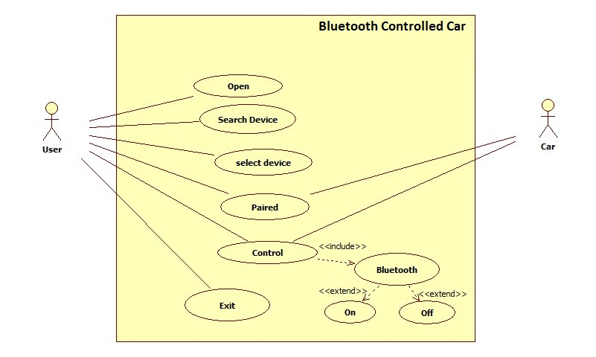
Use Case Diagram

Slide 12
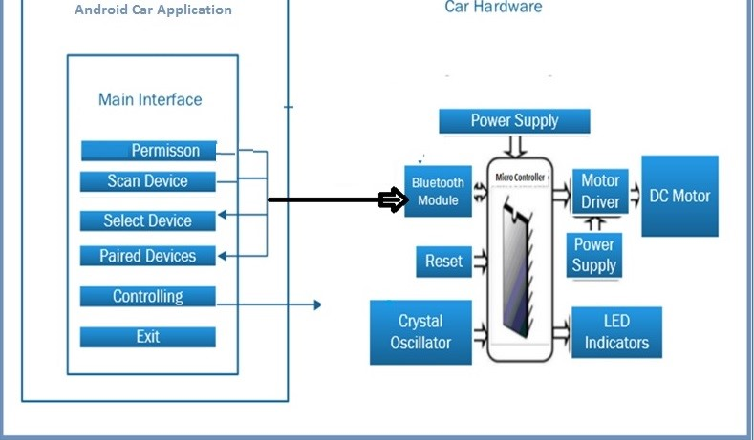
Architectural Diagram

Slide 13
Project Scope
Remote control car using Bluetooth communication.
Android Car with a limited forward, backward, left and right movement.
The speed and direction is not fixed and not potentiometer.
This Android Car is high-end car which use to give precise speed and direction control.

Slide 14
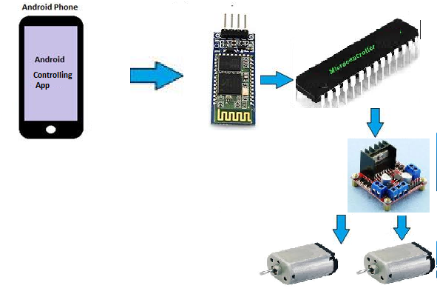
Data Flow Diagram

Slide 15
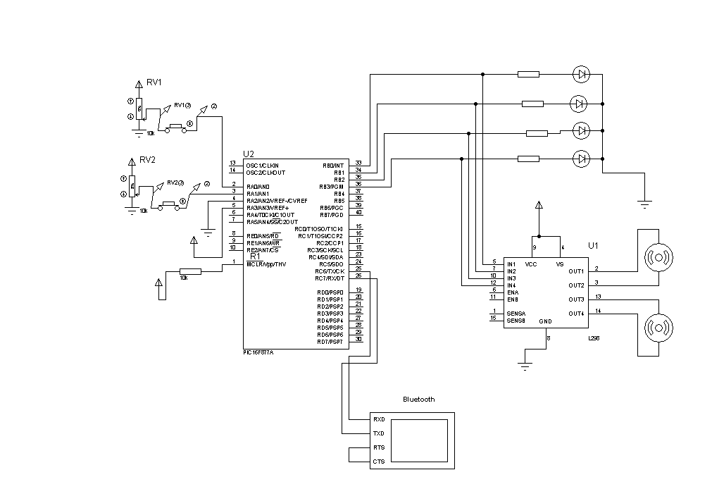
Circuit Diagram

Slide 16
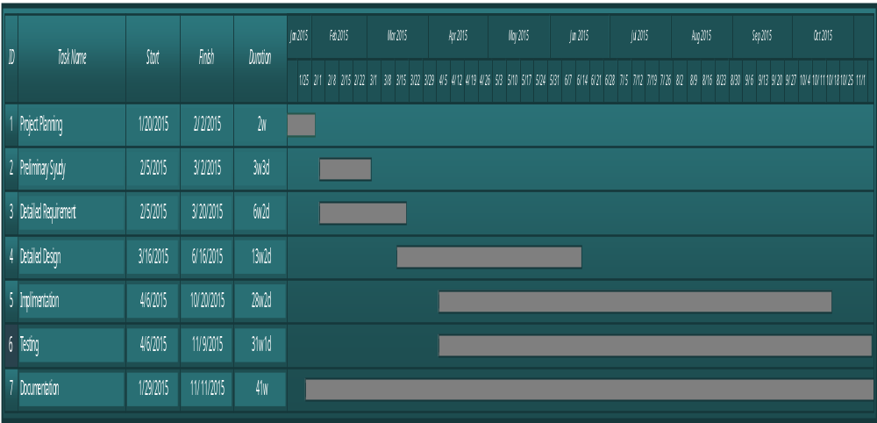
Project Schedule

Slide 17
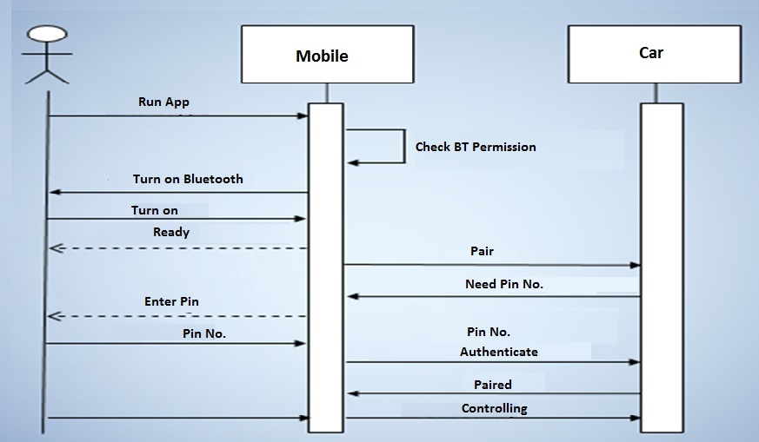
Sequence Diagrams

Slide 18
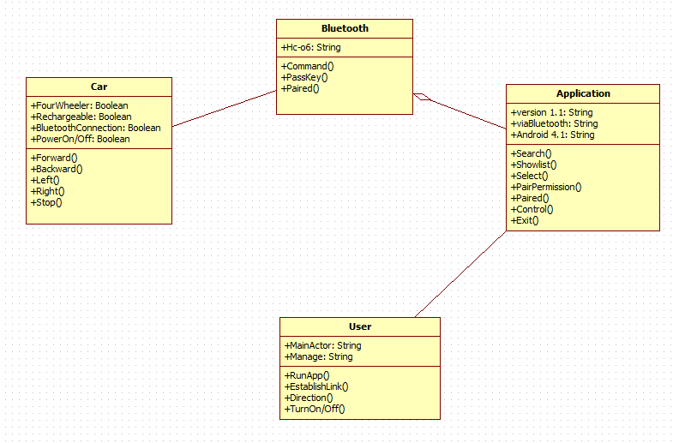
Logical Model/Class Diagram

Slide 19
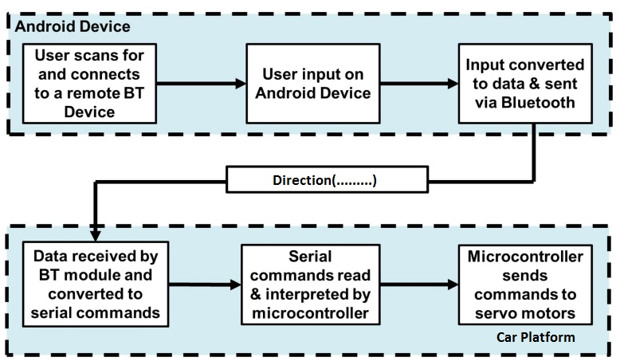
Block Diagram

Slide 20
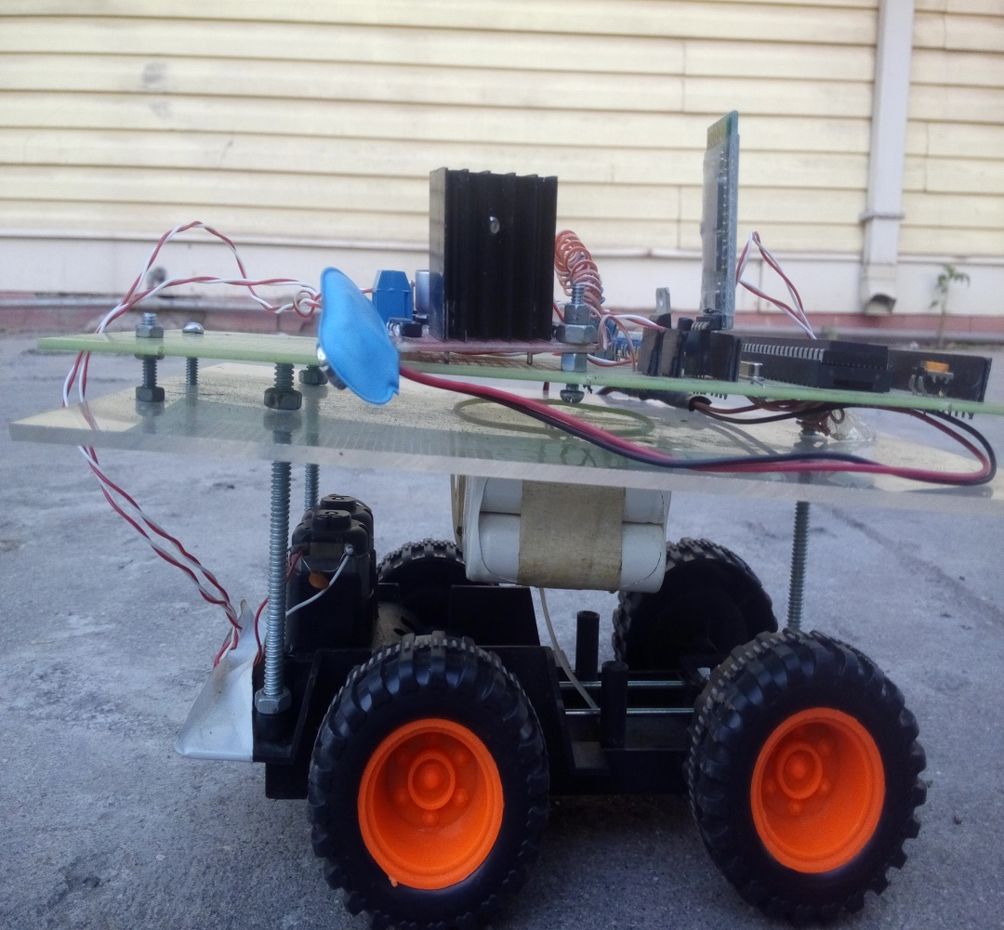
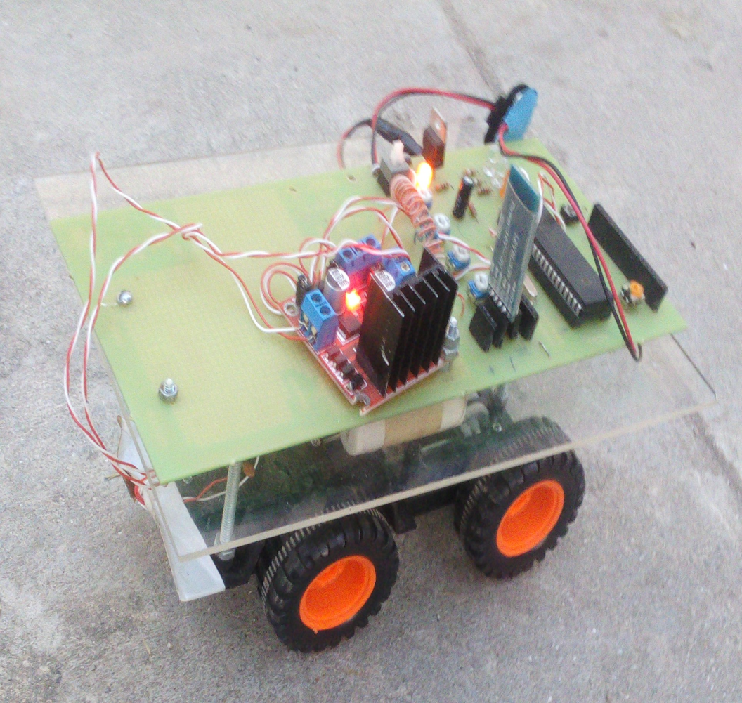
Robotic Car..

Slide 21
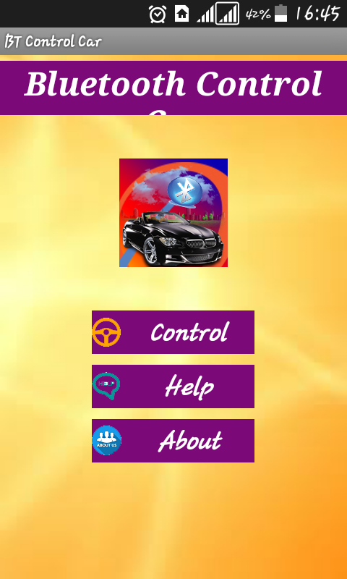
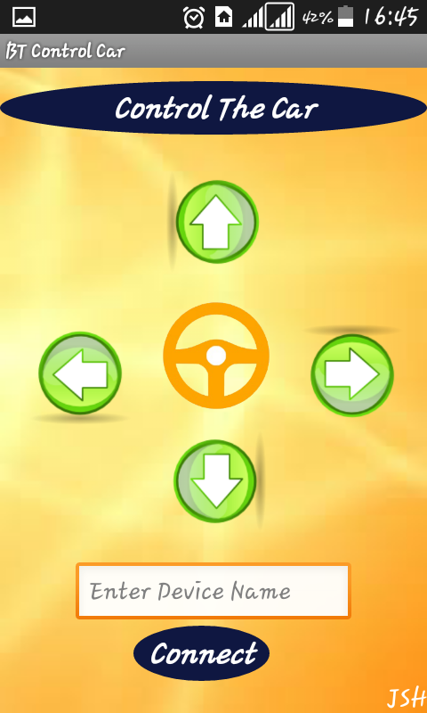
User Interfaces
Main Menu
Controlling Interface

Slide 22
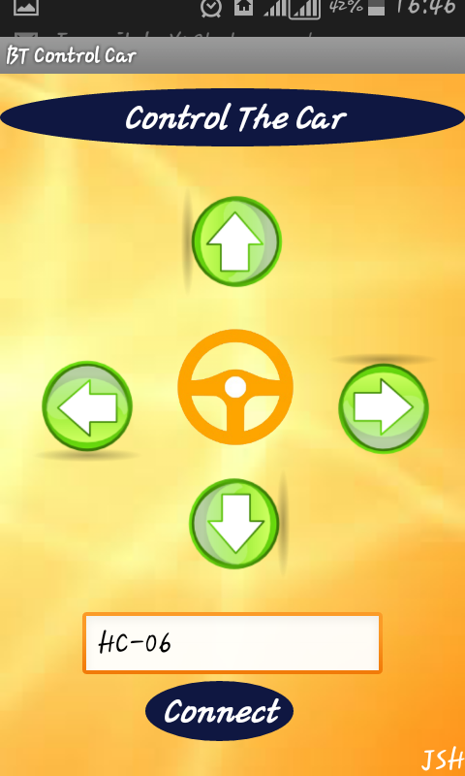
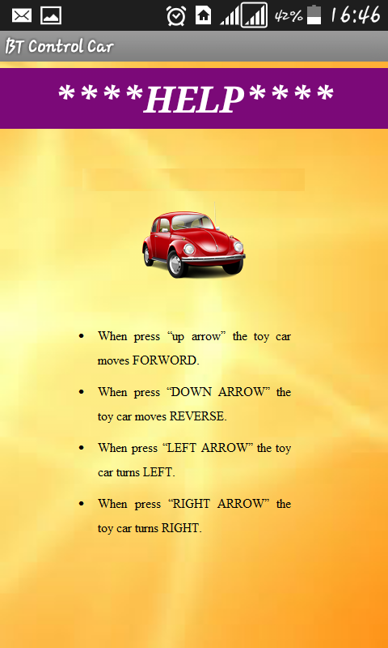
User Interfaces Continued..
Enter Device Name
Instructions About Vehicle

Slide 23
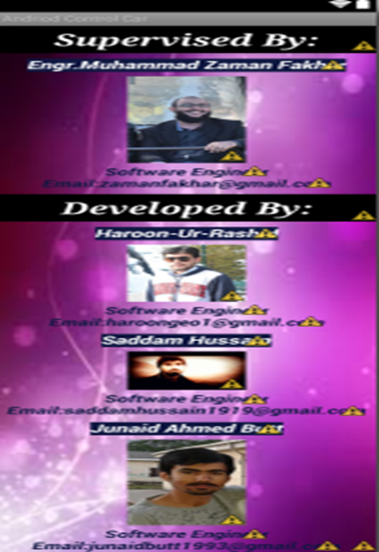
User Interfaces Continued..
About Supervisor and Developer

Slide 24
Tools
Eclipse Studio/Android Studio
Java Platform JDK
Dev C++
Android SDK
Proton IDE
Proteus 7.8
Hyper Terminal
Adobe Photoshop CS6
Microsoft Visio 2013
Star UML

Slide 25
Conclusion:
Some possible and future implementations are as bellow:
In house hold for carrying various things like trays of food or moving sound system.
In hospital we can implement it in wheelchair.
In office for carrying large amount of files from one place to another.
It can be used as a smart trolley in shopping Malls.

Slide 26
Conclusion Continue…
The Robotic car can be used to defuse a bomb, enter into rubble could save a humans life.
Most importantly it can be transformed into a very good toy for the new generation kids who are now growing with a smartphone in his/her hand.

Slide 27
Recommendations
Following improvement of our project may be considered:
Camera can be added to the car so that it work as a spying.
Voice recognition can be added to the car such that it can be motioned by speaking directly through mouth.
Speed control while using accelerometer can also be introduced.

Slide 28
Recommendations Continue…
High weight carrying properties can be given to this car so that many more mechanical or other functions can be installed in it.
Friendly design can be given to it so that it can be representing in more commercial way.
More functions can be added to android application.
Distance of control can be increased.

Slide 29


  Welcome Questions!

